Slide 1
The Effect of Macroeconomic Indicators on Stock Market Performance
Team 011:
Thomas Byrne, Liangqu Chen, Jari Oinas,
Anuj Shelat, and David Chang
Notes:
Thomas, then everybody else introduces themselves
Welcome to Team 11’s project presentation. The project title is: The Effect of Macroeconomic Indicators on Stock Market Performance. My name is Thomas Byrne

Slide 2
Overview
Primary Research Question:
“What is the relationship between the U.S. stock market and U.S. macroeconomic indicators?”
Our hypothesis was that:
There is a strong causal relationship between U.S. macroeconomic factors and the U.S. stock market’s performance.
Approach:
We built a Linear Regression model using least squares estimation, regressing S&P 500 stock market return data on macroeconomic factors such as the U.S. GDP or CPI.
Notes:
Thomas: To give a quick overview of the project:
Our primary research question was “What is the relationship between the U.S. stock market and macroeconomic indicators for the United States?”.
Our hypothesis was that there is causal relationship between the macroeconomic factors and the U.S. stock market’s performance.
In this team project, we attempted to build a linear regression model of the S&P 500 stock market’s returns and fit it to macroeconomic predictors like GDP or CPI.

Slide 3
Academic Literature Review
We completed a review of the academic literature.
The literature suggests the existence of a relationship between macroeconomic factors and the stock market’s returns:
Efficient Market Hypothesis (Fama, 1970)
Capital Asset Pricing Model (CAPM)(Sharpe, 1964; Markowitz, 1952).
Dividend Discount Model (Gordon and Shapiro, 1956)
Arbitrage Pricing Theory (Ross, 1976)
The stock market responds to or is a leading indicator to changes in macroeconomic factors. (Comincioli, 1996. IMF, 1998).
Notes:
Jari
In our review of the academic literature, most scholars agree that there is a relationship between the macroeconomic predictors and the stock market’s returns.
Our review included a number of well known theories or models such as:
Efficient Market Hypothesis
The Capital Asset Pricing Model
The Dividend Discount Model
The Arbitrage Pricing Theory.
All of these use macroeconomic factors to predict market returns.

Slide 4
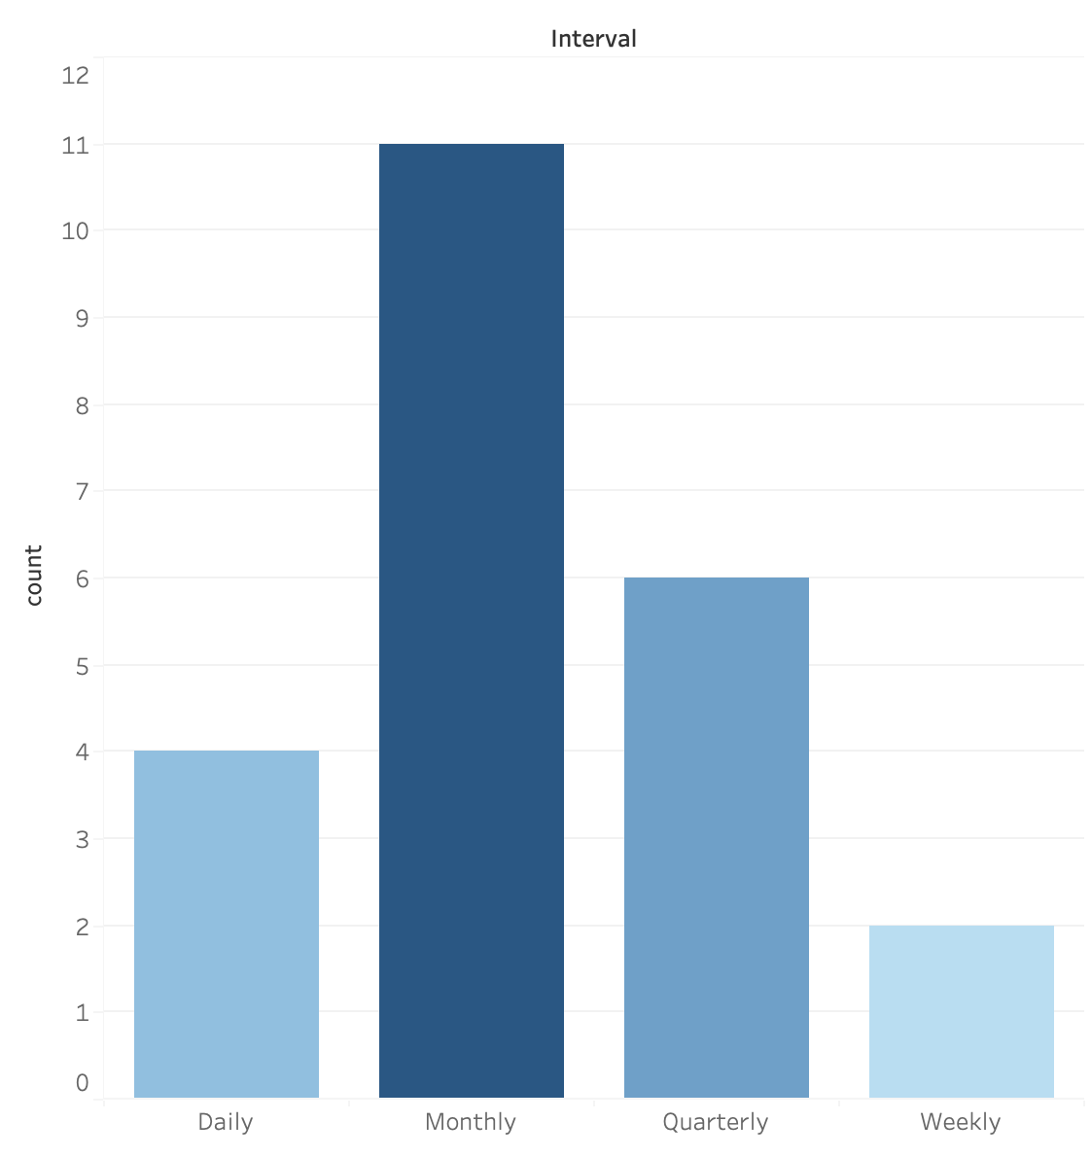
Overview of Data Preparation
We compiled the market return and macroeconomic predictors dataset for the time period 1967-2022 using the FRED, yFinance, NASDAQ APIs.
21 independent variables (macroeconomic) / 1 dependent variable (SP500)
Most of the predictors are on the monthly level.The response – SP 500 index is daily value
We transformed all data to: Month over Month and Quarter over Quarter.
Transformed to % change over previous time interval
For monthly dataset, we forward filled all the null values for quarterly predictors
Notes:
Leon

Slide 5
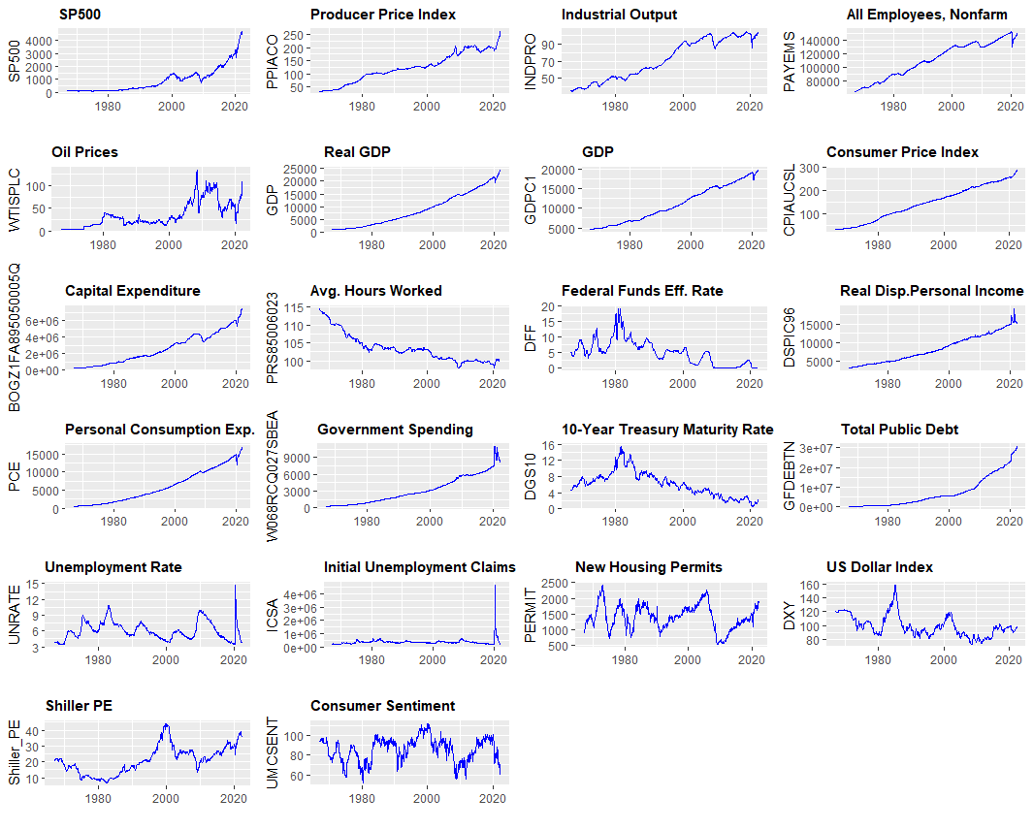
Data Overview - Trends
SP500 Returns (mean / max / min):
MoM: 0.7% / 12.0% / -20.4%
QoQ: 2.0% / 20.2% / -27.2%
From the trends for SP500 and Macroeconomic variables we can see that many look similar
Some variables look almost identical (GDP, CPI, Personal Income, Personal Consumption exp. etc.)
We can already see that multicollinearity will be affecting between some of the variables
The other more “cyclical” variables seem interesting for shorter term predictions
Notes:
Jari
Trends between 1967 - 2022 to visualize the data

Slide 6
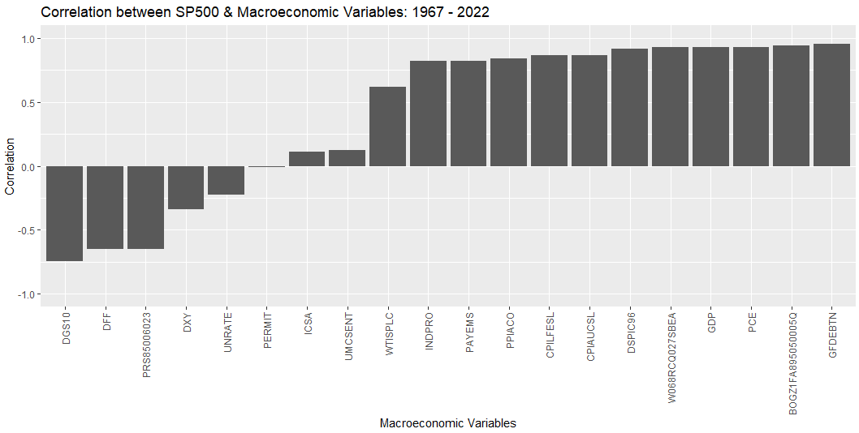
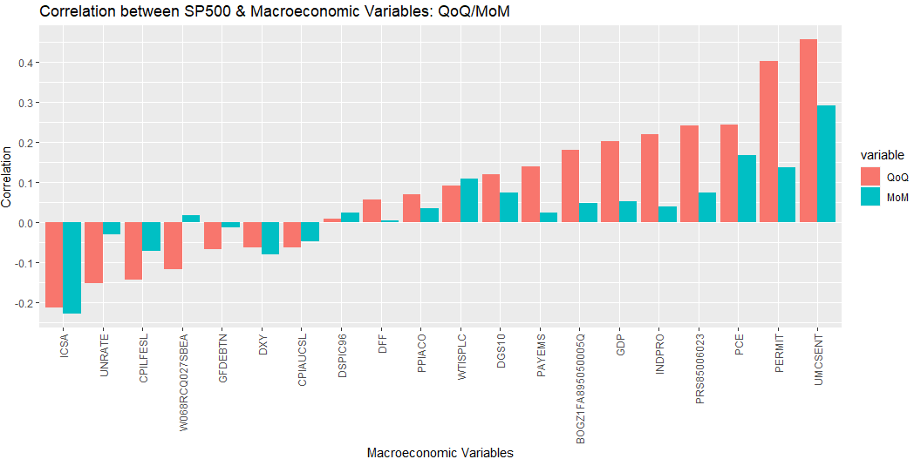
Data Overview - Correlation
Looking at the longer term trends, and also correlation between SP500 and the macroeconomic variables, the relationship seems pretty clear
During 1967 - 2022, there is a high correlation between SP500 and most of the variables
When shortening the timeframe to SP500 performance QoQ and MoM, correlation becomes weaker
Certain variables have stronger correlation with shorter time frames but not with longer time frame:
Customer sentiment (UMCSENT)
New Housing permits (PERMIT)
Unemployment claims (ICSA)
Notes:
Jari
Continuing the data overview and exploration
Top graph is showing correlation between uncorrected SP500 index and macroeconomic variables
Bottom graph is showing correlation between SP500 MoM and QoQ and m.variables

Slide 7
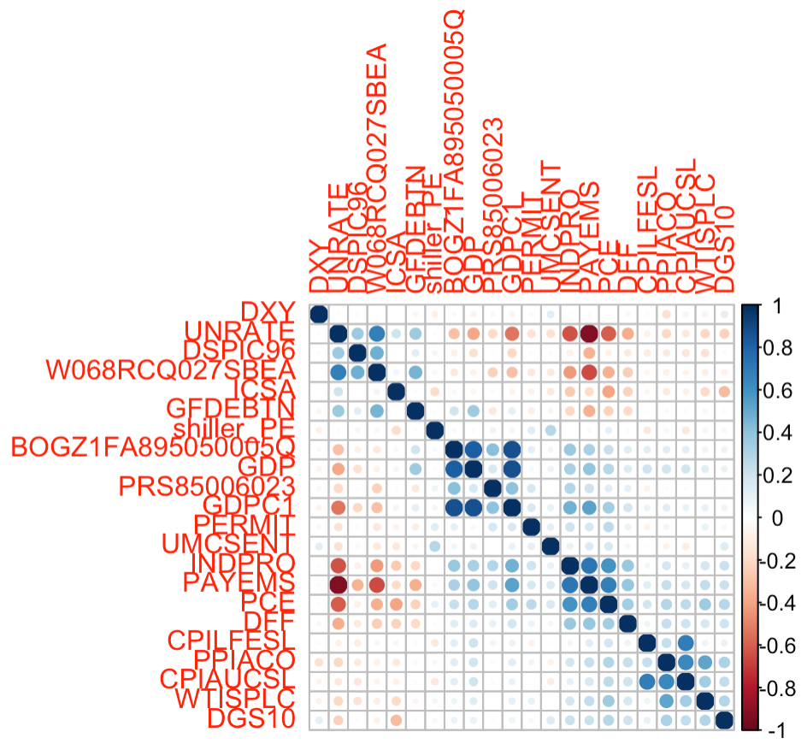
Collinearity
Correlation Plot for MoM
Correlation Plot for the data sets suggest multicollinearity.
Strong Negative Correlations:
Unemployment rate, Personal Consumer Expenditures (PCE), Total Nonfarm Payroll, Industrial Output (INDPRO), and Real GDP
Government Spending (W068RCQ027SBEA), Total Non-Farm Payroll, and Industrial Output
Strong Positive Correlations:
Unemployment Rate and Government Spending
CPI (CPIAUCSL) and CPI Less Food and Energy (CPILFESL)
PPI (PPIACO) and CPI
Capital Expenditure GDP, and Real GDP
Notes:
Anuj
This table shows the multicollinearity that exists among some of of our predictors. The blue points being the strong positive correlations and the red points being the strong negative correlations.

Slide 8
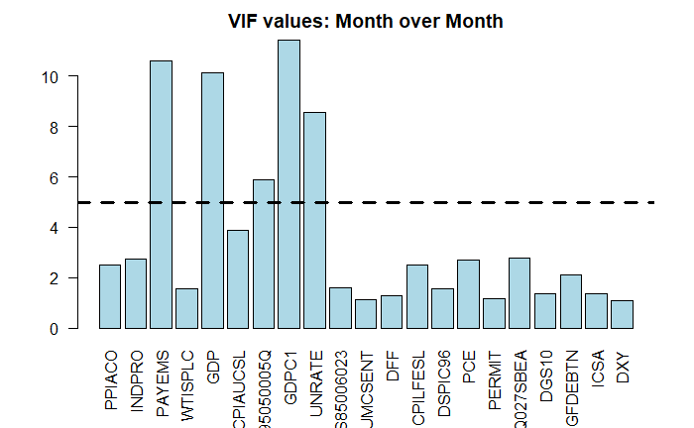
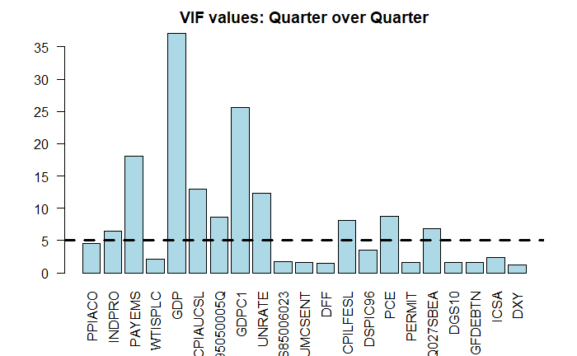
Collinearity
As shown in the VIF charts, we discovered that there was a high likelihood of problematic multicollinearity in both data sets.
In the month over month (MoM) data set, there were 5 predictors with a VIF greater than 5.
In the quarter over quarter data (QoQ) set, a total of 9 predictors had a VIF greater than 5.
Notes:
Anuj
We also looked at the issue of multicollinearity, using a variable inflation factor (VIF) chart.
5 factors were shown to be problematic for MoM. 9 factors for QoQ.

Slide 9
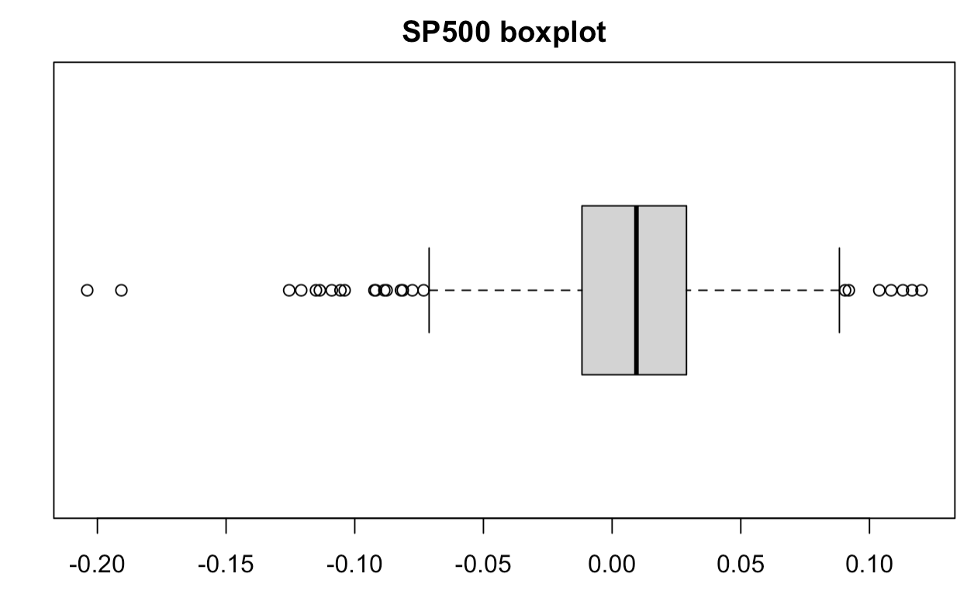
Outlier Detection
Box Plot for SP500 Returns (MoM)
We completed Grubbs Test on both tails for Month over Month (MoM) and Quarter over Quarter (QoQ) datasets. We did discover data points that could be classified as outliers with a confidence interval of 95%
However, we choose not to remove the outliers as they reflect real, historical return data rather than erroneous data.
Notes:
Leon
We choose to include outliers because we would like our descriptive model to reflect correlation between macroeconomic condition and extreme market returns. (Removal did improve overall model fit)

Slide 10
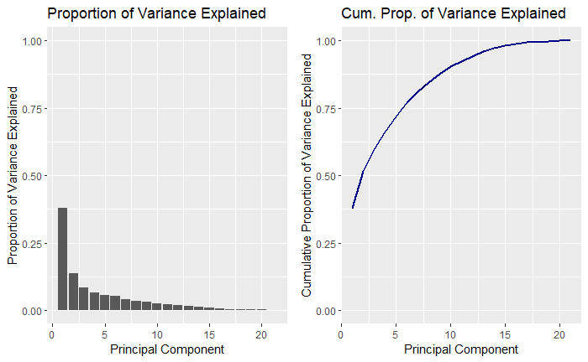
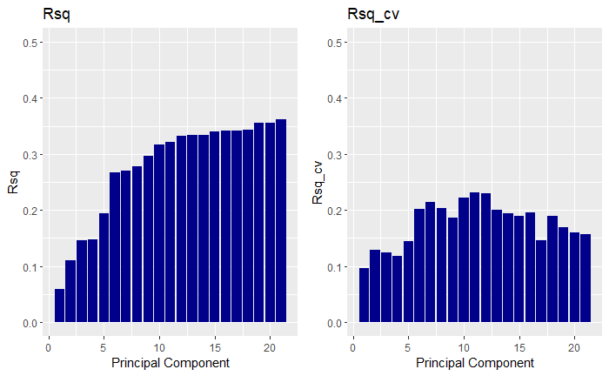
Modeling Overview
We modeled the relationship between the S&P500 and macroeconomic predictors using the linear regression model.
Two sets of models: Month over Month Linear Regression, Quarter over Quarter Linear Regression.
Pre-processing: center + scaling, with and without Principal Component Analysis (PCA)
Hyperparameters:
Variable Selection: Stepwise Regression, Regularization
Regularization: LASSO, ElasticNet
We completed model training using train-test data split. We then evaluated each trained model using cross-validation to estimate each model’s R-squared value.
QoQ PCA by R Squared and Proportion of Variance Explained
Notes:
David

Slide 11
Model Performance
Hyperparameters | MoM cross-validated R Sq | QoQ cross-validated R Sq
Full Model (least square estimation) | 0.12 | 0.31
Stepwise Regression | 0.10 | 0.22
ElasticNet | 0.04 | 0.26
PCA | -0.46 | 0.23
PCA Stepwise | 0.12 | 0.23
PCA ElasticNet | 0.10 | 0.23
PCA Lasso | 0.09 | 0.20
Notes:
David: Here we show the final cross-validated model fit for all of the models that we trained.
Best performing model was QoQ Linear Regression model performed best. QoQ performed much more strongly over MoM.
Principal component analysis did not improve model fit. Variable Selection did not improve model performance.

Slide 12
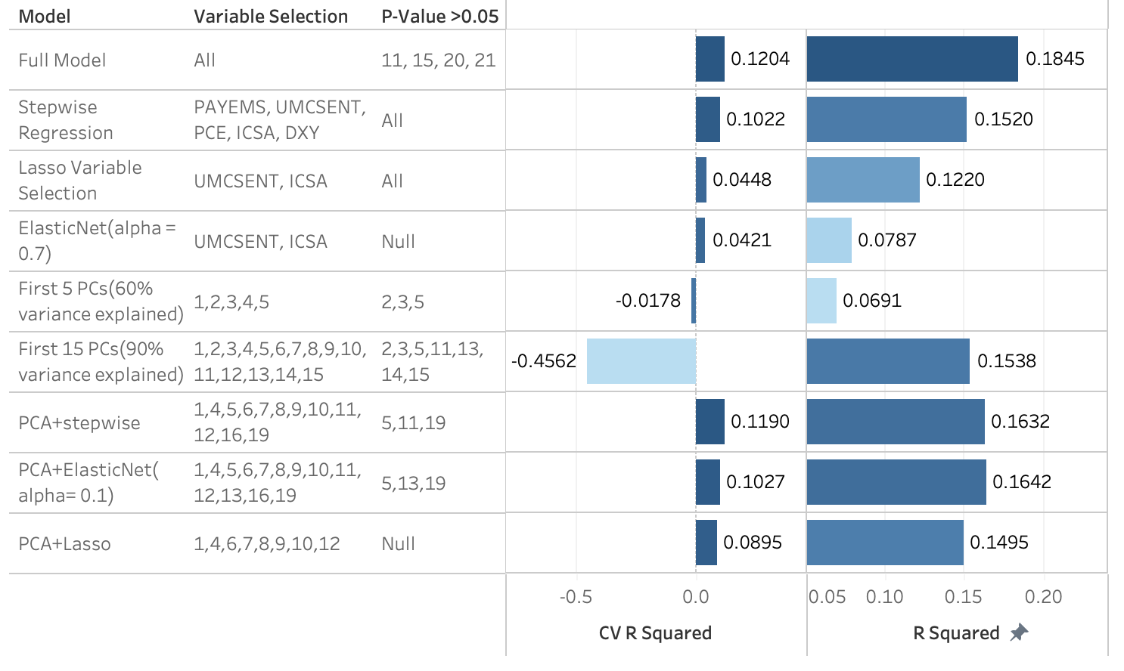
MoM Models Results
In general, month over month linear regression model fit was poor. Full model performed best.
Variable Selection did not result in a better cross-validated model fit compared with full model.
Variable Selection on PCs leads to better fit
All models exhibited overfitting.
PCA transformation improves the fit of models
Notes:
Leon

Slide 13
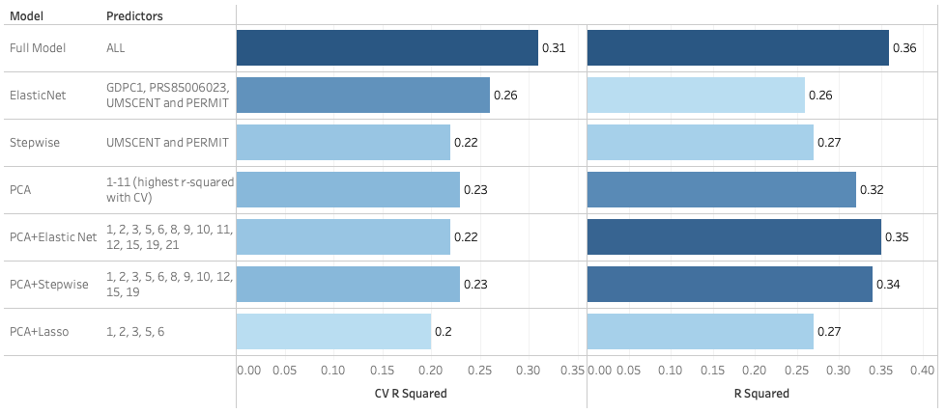
QoQ Model Results
Notes:
Anuj
This table summarizes the Quarterly results
As previously mentioned Variable selection did not improve the model performance
With the stepwise regression.
The forward selection yielded us with a model using 2 predictors.
The backward selection yielded us with a model using 8 predictors.
When both directions, the resulting was the same as the forward selection model.
We also performed an elastic net regression which resulted in a model using 4 predictors.

Slide 14
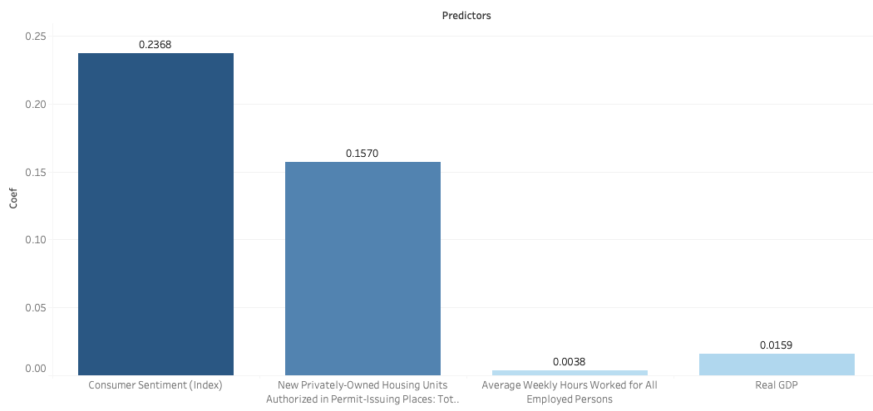
Elastic Net QoQ model
Study of coefficients
Notes:
Anuj
Doing variable selection with the elastic net model we were left with these 4 predictors. Customer sentiment had the strongest effect, which was true for both out MoM and QoQ. Average weekly hours worked had the smallest effect

Slide 15
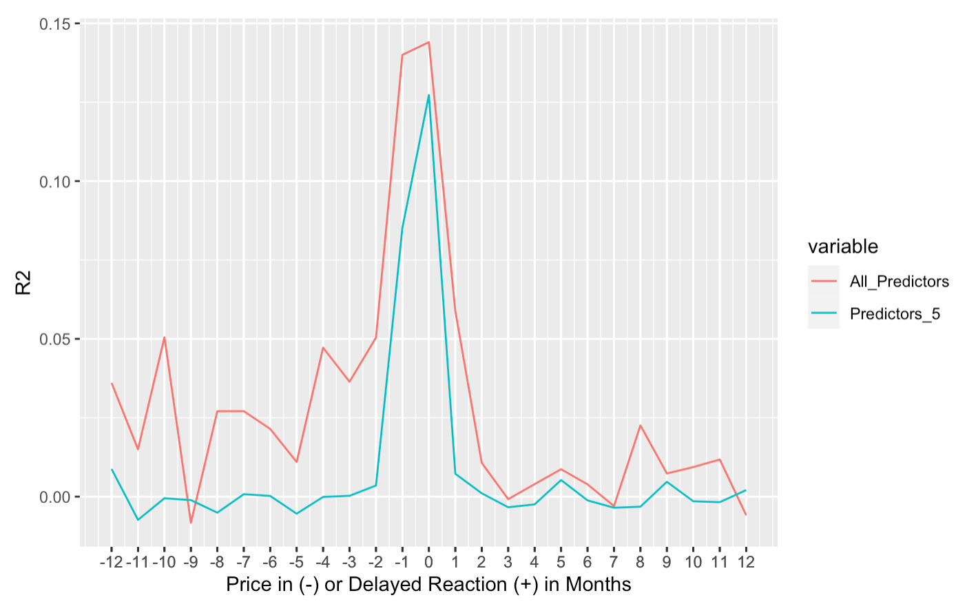
Do Market Returns Lag or Lead Macroeconomic Predictors?
We transformed the Market return, adding lag/lead.
Market does not seem to lag.
Best R-Squared is 0 months. Market seem efficient and reflect current value.
Market may potentially price in because R-Squared of -1 month is close to the best R sq value.
Notes:
Leon
Poor R2 of lagging model suggests market does not to lag to react
The model with no change still has the highest R2. so market seems very efficient and reacts quickly (intra-month)
Market may potentially price in data ahead of time because R2 of -1 month is very close to that of the model with no change
Future work

Slide 16
Binned Model Fit (R Squared Values)
 | Bin 1 (1967-1971) | Bin 2 (1972-1976) | Bin 3 (1977-1981) | Bin 4 (1982-1986) | Bin 5 (1987-1991) | Bin 6 (1992-1996) | Bin 7 (1997-2002) | Bin 8 (2003-2006) | Bin 9 (2007-2011) | Bin 10 (2012-2016) | Bin 11 (2017-2022)
Initial Model | 0.306 | 0.595 | 0.402 | 0.645 | 0.423 | 0.590 | 0.470 | 0.473 | 0.726 | 0.567 | 0.649
Significant Parameter Model | 0.041 | 0.205 | 0.165 | 0.487 | 0.005 | 0.428 | 0.228 | 0.249 | 0.461 | 0.184 | 0.516
Select Parameter Model | 0.041 | 0.316 | 0.267 | 0.173 | 0.199 | 0.105 | 0.252 | 0.234 | 0.483 | 0.121 | 0.549
Initial Model (Cross Validation) | 0.005 | 0.057 | 0.168 | 0.419 | 0.130 | 0.142 | 0.294 | 0.018 | 0.108 | 0.000 | 0.005
 | Bin 1 (1967-1976) | Bin 2 (1977-1986) | Bin 3 (1987-1996) | Bin 4 (1997-2006) | Bin 5 (2007-2016) | Bin 6 (2017-2022)
Initial Model | 0.348 | 0.406 | 0.344 | 0.306 | 0.576 | 0.649
Significant Parameter Model | 0.170 | 0.292 | 0.201 | 0.197 | 0.417 | 0.516
Select Parameter Model | 0.160 | 0.200 | 0.125 | 0.188 | 0.362 | 0.549
Initial Model (Cross Validation) | 0.310 | 0.436 | 0.351 | 0.358 | 0.527 | 0.753
Notes:
Thomas
The team decided to test models which binned the dataset into five and ten year subsets in the hope that different parameters would have a greater effect in select time periods and provide a better fit. In testing, the team was unable to limit the number of parameters, choosing only the most significant parameters or the parameters chosen by stepwise regression resulted in worse correlations. The team also cross validated the models to test for overfitting. The five year bin models appeared to be over fit due to lower r-squared values while the ten-year bin models looked better.

Slide 17
Conclusion
Model fit suggests weak support for our hypothesis that there is a causal relationship between macroeconomic predictors and the performance of the stock market. The relationship is complex and it is not possible to rule out other factors that may cause over or under- performance.
QoQ performed significantly better than MoM: using a high time frame interval for macroeconomic data was more predictive of the market return.
Our best performing model had a cross-validated R-Squared value of 0.31. This suggest that firms and traders should not discount the importance of the economy in the stock market’s performance.
Notes:
Thomas

Slide 18
Conclusion (continued)
Future Areas of Inquiry:
ARIMA regression model (using a time series based model)
Forecasting the market return for the next quarter/month
GARCH model
Classification model for market direction (positive or negative returns)
Modeling international stock markets (developed, emerging markets)
Binned Modeling suggests that model performance could be improved by using regression spline modeling.
What predictors are most important or significant during different market conditions? (i.e. Merrill Lynch’s Investment Clock: market returns depend on what phase of the business cycle we are in, especially by factors such as inflation and economic growth.)
Notes:
David

Slide 19
Bibliography
Comincioli, Brad (1996) "The Stock Market As A Leading Indicator: An Application Of Granger Causality," University Avenue Undergraduate Journal of Economics: Vol. 1 : Iss. 1, Article 1. https://digitalcommons.iwu.edu/uauje/vol1/iss1/1
Fama, Eugene (1970). "Efficient Capital Markets: A Review of Theory and Empirical Work". Journal of Finance. 25 (2): 383–417. doi:10.2307/2325486. JSTOR 2325486.
Gordon, M.J and Eli Shapiro (1956) "Capital Equipment Analysis: The Required Rate of Profit," Management Science, 3,(1) (October 1956) 102-110. Reprinted in Management of Corporate Capital, Glencoe, Ill.: Free Press of, 1959.
Markowitz, H.M. (March 1952). "Portfolio Selection". The Journal of Finance. 7 (1): 77–91. doi:10.2307/2975974. JSTOR 2975974.
Ross, Stephen A (1976-12-01). "The arbitrage theory of capital asset pricing". Journal of Economic Theory. 13 (3): 341–360. doi:10.1016/0022-0531(76)90046-6. ISSN 0022-0531.
Sharpe, William F. (1964). "Capital asset prices: A theory of market equilibrium under conditions of risk". Journal of Finance. 19 (3): 425–442. doi:10.1111/j.1540-6261.1964.tb02865.x. hdl:10.1111/j.1540-6261.1964.tb02865.x.
Notes:
Here, we’ve provided our references.

